Slide 1

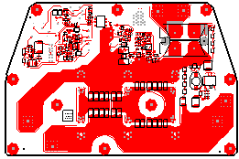
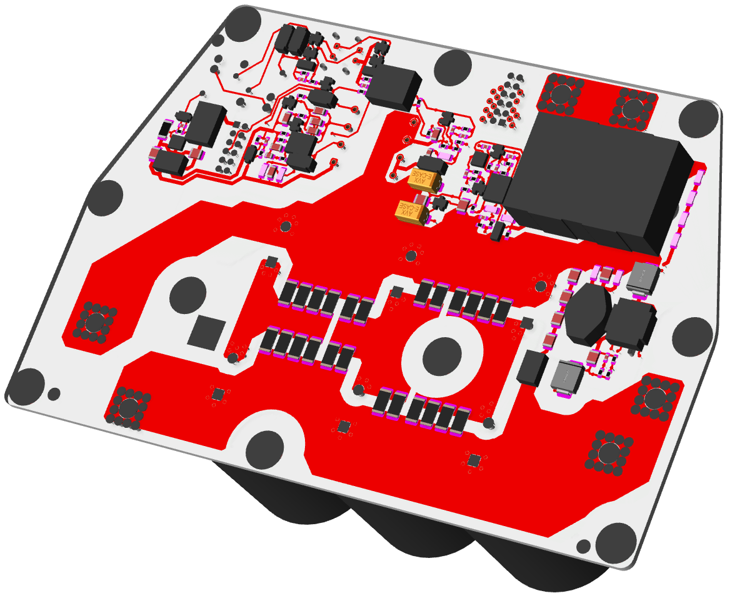


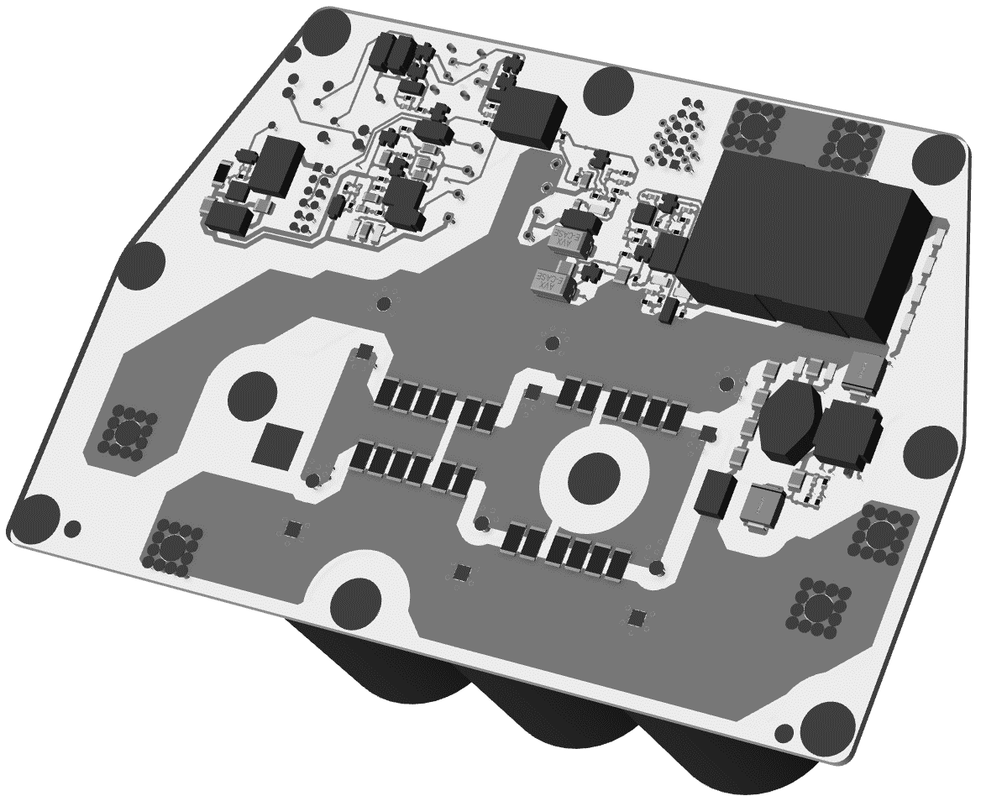

Requirements
Bom authored in schematic tool, including variants and alternate parts (an alternate part share the same footprint/package and reference designator, R1-1, R1-2 etc.)
Schematic to have capability of transferring mechanical (heatsinks, fixings etc.), chemical parts (adhesive, thermal grease etc.) to TC bom and alternate parts
Bom mastered in Teamcenter, ability to run a comparison report between TC and schematic to keep synchronized should any changes be made directly in TC
eBom generated from NX (or SolidWorks) should contain all ECAD and MCAD parts and through TC manage bom variants and alternate parts
Generic overview
VARIANT 1 CCA SCHEMATIC
PWB - ALLEGRO
PWB – NX CCA VARIANT 1
VARIANT 1 CCA BOM
PWB – NX CCA VARIANT 2
VARIANT 2 CCA SCHEMATIC
Structure Manager Controls NX CCA
PWB – NX CCA VARIANT n etc.
BOMS
TEAMCENTER
Is this correct?
VARIANT 2 CCA BOM
Boms exported from OrCAD directly into Teamcenter

Slide 2
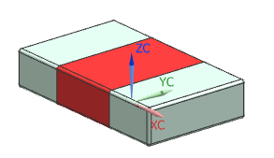
ECAD/MCAD INTEGRATION, MANAGING ECAD 3D MODELS IN NX & ALLEGRO, proposed method
PWB CORE SCHEMATIC
PWB - ALLEGRO
NETLIST
PCB.Xchange
PWB – NX CCA VARIANT 1
Bi-directional Transfer of PWB Profile and Parts
Part Data transferred, REFDES & Footprint only:
R1, R2, R3, R4 RC0805 – No part numbers
CCA variants generated from a single IDX file
VARIANT 1 CCA SCHEMATIC
PWB – NX CCA VARIANT 2
Moog part numbers not visible directly from NX model, refer to variant bom in Teamcenter.
VARIANT 1
VARIANT 1 CCA BOM
R1 & R2
R3 & R4
VARIANT 2
VARIANT 2 CCA SCHEMATIC
R1 & R2
R3 & R4
Boms exported from OrCAD directly into Teamcenter, alternate parts managed*
ECAD CCA BOM generated from Schematic dsn file, Schematic/BOM Variants extracted as required
Moog Part Numbers not transferred to NX Model, enables a single PWB & CCA to represent several Design variants
BOM value changes do not require updating of the NX Model
One to many ECAD PRT Library, a single 3D model used by all items of the same physical package
Turn of any ECAD parts in the NX model so they do not show in Temacenter
VARIANT 2 CCA BOM
TEAMCENTER
CA29801-105
CA29801-115
CB52571-289
CB52571-300
RC0805
Through EDA Gateway?
*alternate parts are managed by ‘Smart’ table on the schematic, see example

Slide 3


ECAD/MCAD INTEGRATION, MANAGING ECAD 3D MODELS IN NX & ALLEGRO, proposed method
PWB CORE SCHEMATIC
PWB - ALLEGRO
NETLIST
PCB.Xchange
PWB – NX CCA VARIANT 1
Bi-directional Transfer of PWB Profile and Parts
PWB CORE SCHEMATIC
Non-EBOM, base ID
ECAD item revision (AD4_Elec_PartRevision)
EDADesOrcadBrd dataset
EDADesOrcadSch dataset
EDADesOrcadSim dataset
PDF dataset (rendering)
Part Data transferred, REFDES & Footprint only:
R1, R2, R3, R4 RC0805 – No part numbers
PWB ALLEGRO
EBOM, base & dash ID
Moog item revision (AD4_Mech_PartRevision)
EDADesCadBrd dataset (specification)
EDADesCadSch dataset (specification)
EDADesCadSim dataset (specification)
PDF dataset (rendering)
CCA variants generated from a single IDX file
VARIANT 1 CCA SCHEMATIC
PWB – NX CCA VARIANT 2
Moog part numbers not visible directly from NX model, refer to variant bom in Teamcenter.
CCA NX
EBOM, base & dash ID
Moog item revision (AD4_Mech_PartRevision)
BOMViewRevision dataset
UGMASTER dataset (specification)
UGPART dataset (specification)
PDF dataset (rendering)
VARIANT 1
VARIANT 1 CCA BOM
R1 & R2
R3 & R4
VARIANT 2
VARIANT 2 CCA SCHEMATIC
R1 & R2
R3 & R4
Boms exported from OrCAD directly into Teamcenter, alternate parts managed*
ECAD CCA BOM generated from Schematic dsn file, Schematic/BOM Variants extracted as required
Moog Part Numbers not transferred to NX Model, enables a single PWB & CCA to represent several Design variants
BOM value changes do not require updating of the NX Model
One to many ECAD PRT Library, a single 3D model used by all items of the same physical package
Turn of any ECAD parts in the NX model so they do not show in Temacenter
VARIANT 2 CCA BOM
TEAMCENTER
CA29801-105
CA29801-115
CB52571-289
CB52571-300
RC0805
Through EDA Gateway?
*alternate parts are managed by ‘Smart’ table on the schematic, see example

Slide 4
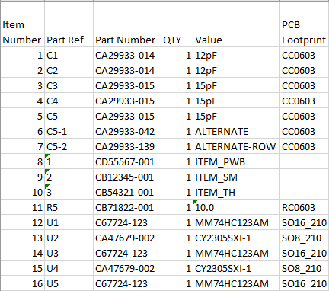
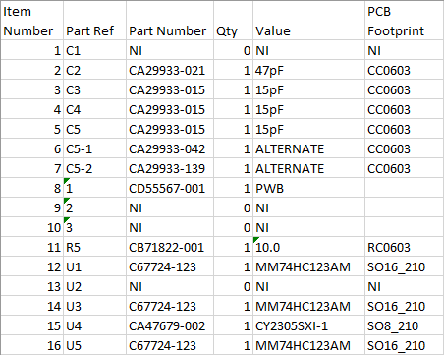
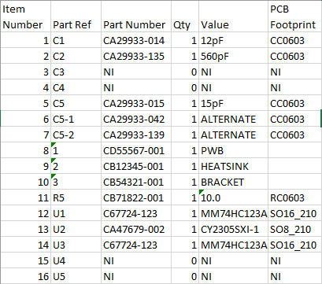
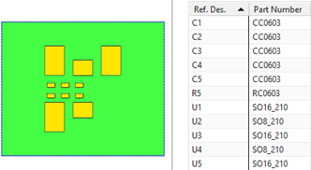
Notes
The bom is authored in OrCAD (or in future, and System Capture), there will be a separate bom for each bom/schematic variant. Each bom may also include alternates. These boms are loaded directly into Teamcenter (through EDA Gateway?)
For designs with variants, the schematic will contain the Core Design and variants are managed through OrCAD’s Part Manager
The Allegro PCB is driven from the Core Design, i.e., no Variant information is present, other than in the Variants.LST file, which lists which parts are stuffed in each variant, the part numbers should not be included as these will be only from the Core Design, with no reference to any variant part numbers
The Allegro brd file generates the IDX file which in turn is imported to either NX or SolidWorks, but as per #3 only part numbers from the Core Design are present so the resultant NX (or SolidWorks) model contains Core Part Numbers only, the actual part numbers for the Variant comes from OrCAD/Teamcenter. Therefore, it is preferable NOT to transfer part numbers from Allegro, as these may not be correct (depending on Variant configuration) and may cause confusion
Note the OrCAD bom has different part numbers for the Core, Variant 001 and Variant 002. Because only the Core properties get transferred to NX the part numbers in the Assembly Navigator refer to the Core only, there is no reference to Variant Part Numbers. The Variant Parts are available only from OrCAD and Teamcenter.
OrCAD – Core
OrCAD – Variant 001
OrCAD – Variant 002
NX
The data transferred through idx is generated from the Core schematic, no Variant information is present (or available). Part Numbers are not transferred so as to not cause confusion (with possibly incorrect Part Numbers)
In a Variant Managed Schematic, the Core is not used to generate the bom, the bom is created from the Variants
Bom – Variant 001
Bom – Variant 002

Slide 5
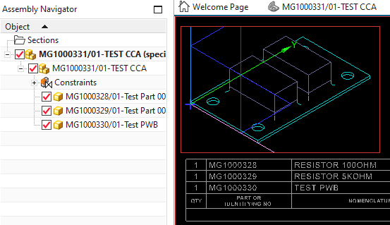
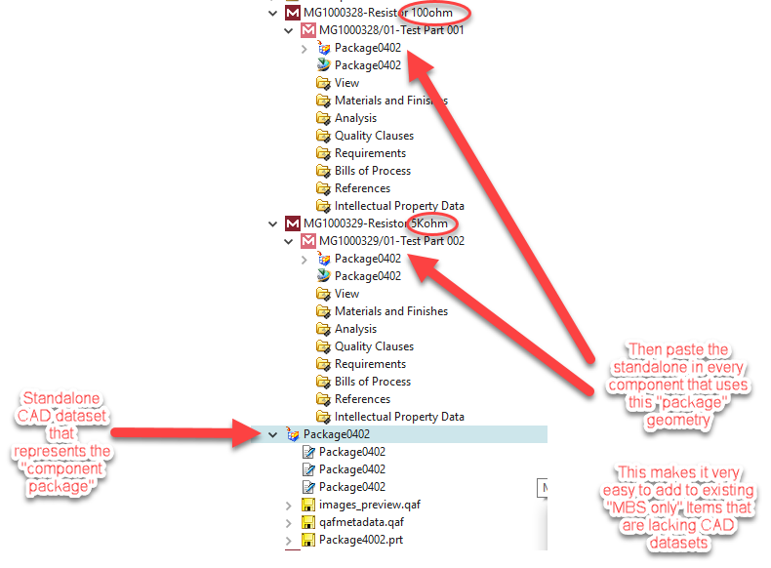
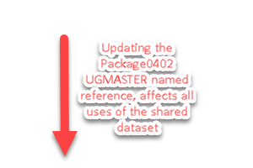
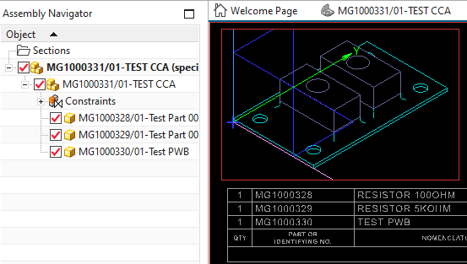
Explore ECAD-TC-MCAD geometry reuse for ECAD defined CCA Product Structures (Paul Bock)

